Slide 1
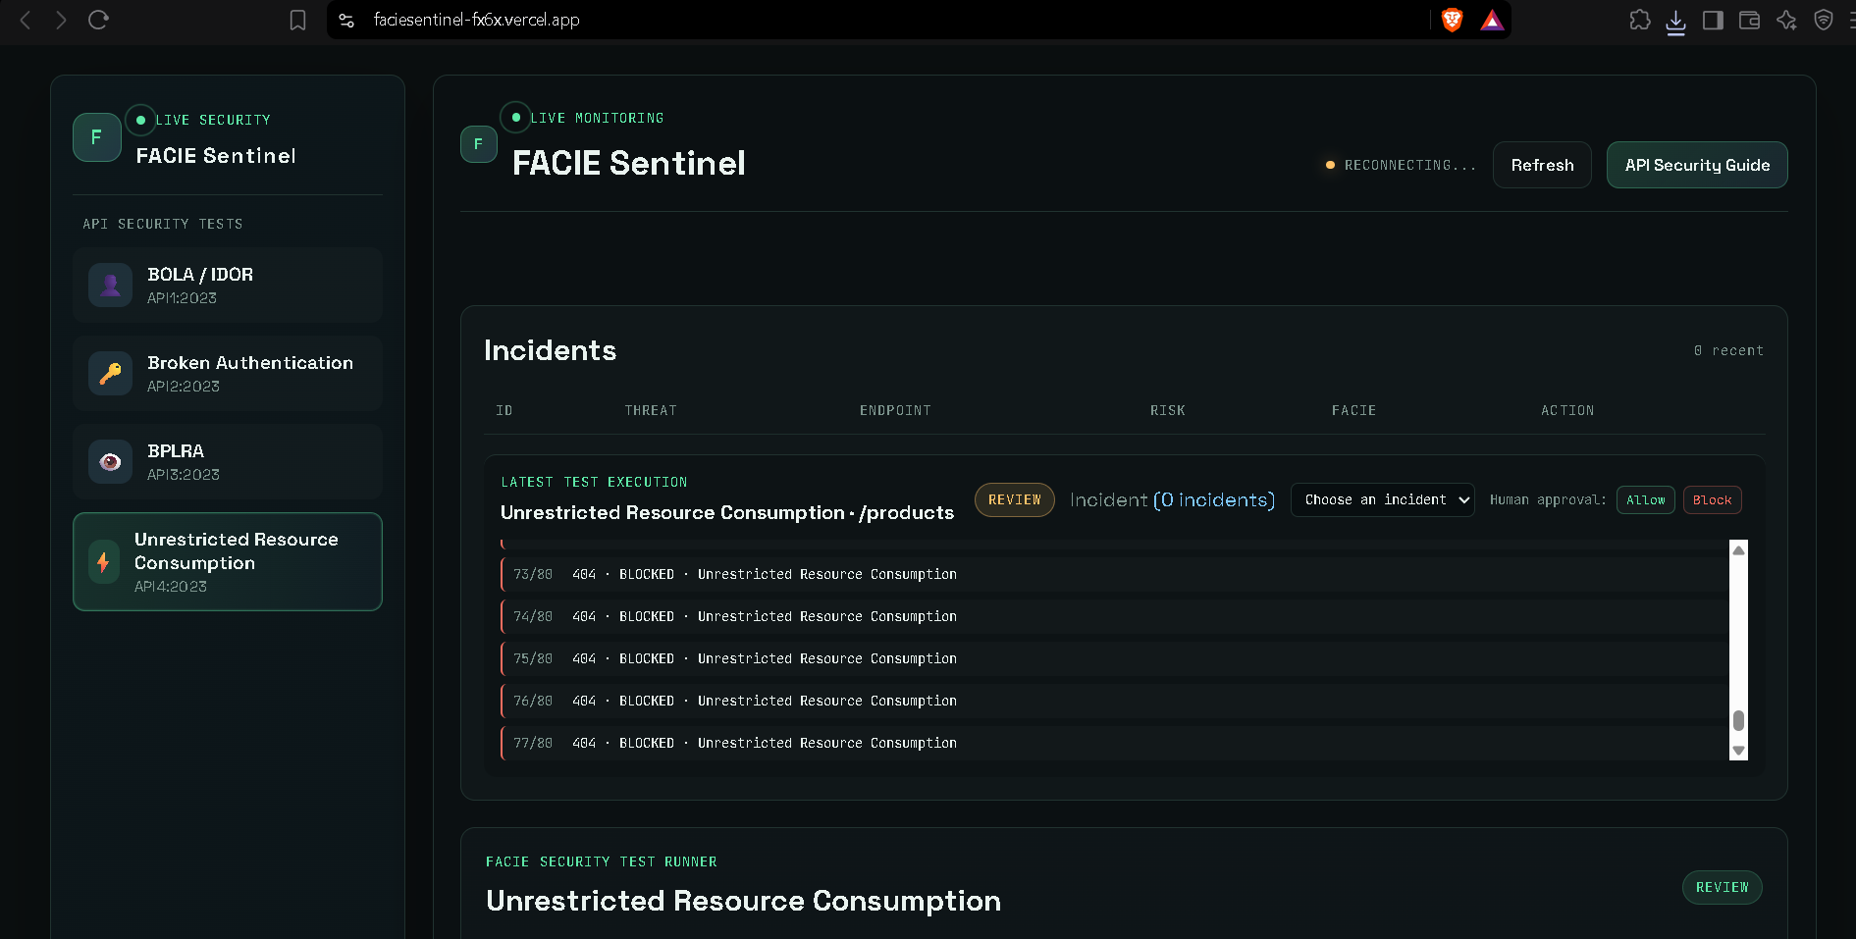
FACIE Sentinel
ADAPTIVE AI-POWERED API SECURITY GATEWAY
Detect. Analyze. Score. Adapt. Respond.

Slide 2
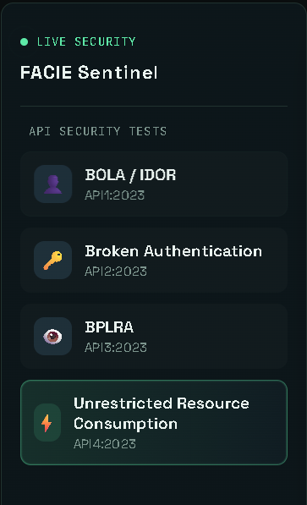
The Problem
Modern APIs face constant automated and behavioral threats
Attack Vectors
SQL & Command Injection
Brute-force & Rate Abuse
BOLA / IDOR & Enumeration
Mass Assignment & Anomalies
The Static Rule Limit
Traditional systems rely purely on static signatures. Individual requests look legitimate in isolation but form malicious behavioral patterns over time.
Organizations need contextual risk assessment.
• FACIE_SENTINEL • CYBERSECURITY TRACK

Slide 3



Our Solution: FACIE Sentinel
Intelligent security layer sitting between clients and APIs
API Request
Threat Detection
Incident Description
Adaptive Action
Incoming payload
Rule & ML Anomaly
Overall Idea of Attack
ALLOW | BLOCK
• FACIE_SENTINEL • CYBERSECURITY TRACK

Slide 4
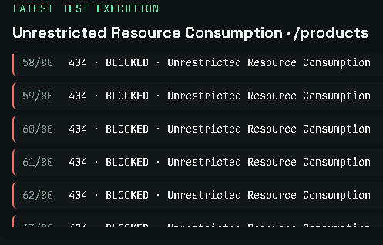
What Makes FACIE Sentinel Different?
Hybrid Detection
Incident Description
Adaptive Response
Explainable Decisions
Combines rule-based signatures with ML anomaly detection.
Synthesizes multiple security signals into overall Idea of attack
.
Dynamic tiering: Allow, Monitor, Rate Limit, Review, Block.
Traces risk factors directly to policy outcomes.
• FACIE_SENTINEL • CYBERSECURITY TRACK

Slide 5
Technology Stack
Deployment
Vercel
Backend Framework
FastAPI (Python)
System Flow
Frontend Dashboard
↓
FastAPI Gateway
↓
[ Detection → ML Anomaly → Risk Engine → Policy ]
↓
SQLite Logging & Response
ML Engine
Scikit-learn (Isolation Forest)
Validation & DB
Pydantic & SQLite
Frontend
HTML, CSS, JS + WebSockets
Backend
Vercel Serverless
• FACIE_SENTINEL • CYBERSECURITY TRACK

Slide 6
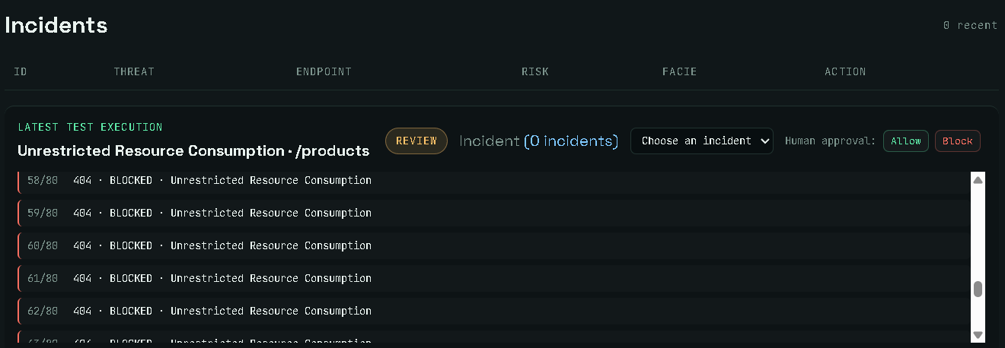
Key Features
Threat Detection
Injection, Brute-force, BOLA/IDOR, enumeration, and rate-abuse scanning.
AI/ML Engine
Isolation Forest anomaly detection and automated behavioral feature extraction.
Incident Description
Synthesizes multiple security signals into overall Idea of attack
.
Human Approval
ALLOW | BLOCK
• FACIE_SENTINEL • CYBERSECURITY TRACK

Slide 7
Adaptive Response Scenarios
Normal Traffic
Injection Payload
Brute Force
API Enumeration
Low Risk → ALLOW
High Risk → BLOCK
Behavioral Spike → RATE LIMIT
Elevated Risk → REVIEW
• FACIE_SENTINEL • CYBERSECURITY TRACK

Slide 8
Impact & Future Scope
Current Impact
Future Roadmap
Transforms API defense by unifying threat detection, quantitative risk assessment, and adaptive response into a single intelligent gateway.
Fewer false positives than static rule-based tools — real users stop getting wrongly blocked.
Fewer missed threats than manual-only review, at a fraction of the response time.
Gives teams without a dedicated SOC a real-time, explainable line of defense for their APIs.
Advanced behavioral profiling
Distributed Redis rate limiting
Automated incident investigation
Feasibility
Core Facie engine and live dashboard already built and deployed at https://faciesentinel-fx6x.vercel.app/
Sits in front of existing APIs as a lightweight layer — no exotic infrastructure required to adopt.
• FACIE_SENTINEL • CYBERSECURITY TRACK

Slide 9
REFERENCES & REPOSITORY LINKS
FACIE Sentinel — Adaptive, risk-aware API security for modern architectures.
Fortune Business Insights — API Security Market Size, Share & Industry Report (2026).
Prototype Link — https://faciesentinel-fx6x.vercel.app/
Repository Link - https://github.com/ShivKum06/FACIE_SENTINEL
• FACIE_SENTINEL • CYBERSECURITY TRACK

